Slide 1
PROJECT TITLE:An Effective Accuracy-Based Disease Prediction on Paddy Cultivation Using Machine Learning
PIP104 PROFESSIONAL PRACTICE-II
VIVA-VOCE
Batch Number:G26
Roll Number | Student Name
20201CSE0140 | Roshan M
20201CSE0137 | Avidi Rohith Krishna
20201CSE0151 | Anandan Tharun Raj
20201CSE0167 | N Hemanth Reddy
Under the Supervision of,
Dr.A Vijaya Kumar
Professor
School of Computer Science Engineering & Information Science
Presidency University

Slide 2
Introduction
• There are main types of paddy diseases such as Bacterial disease , Fungal disease, and Miscellaneous diseases.
These include subcategories like Bacterial blight, Bacterial leaf streak, Brown spot, Leaf smut, Panicle blight, Bronzing etc.
• Bacterial leaf curse (BLB) and Brown spot are currently genuine infections in rice.

Slide 3
Ignorance of appropriate administration to redress paddy plant leaf disease , paddy production is being decreased as of late, to overcome this, appropriate and quick Recognition measures are required for the diagnosis of paddy leaf disease
• This work mainly focuses on the five most common paddy leaf diseases named Brown spot, Healthy leaf , Leaf blast, Bacterial blight, Leaf smut.
• Like all the sectors there is no shortage of AI contributions in the agriculture sector.

Slide 4
• Technology as made it much easier to solve many problems in agriculture, plant disease is one of them.
The crop losses can be minimized if the diseases are corrected, detected and diagnosed if identified early, therefore many researchers have investigated automated rice disease detection based on pattern recognition and machine learning

Slide 5
Literature Review
Title : Adapted approach for Rice leaf disease identification using Images . India , international journal of computer vision and image processing, 2018.
• Author :Dubey , S.R. & Jalal. A. S.
• The authors presented the image processing based approach for rice leaf disease detection.
• First , read input image and transform it from RGB (Red , Green and Blue) to L*a*b(L* value indicates lightness , and a* and b* are chromaticity coordinates) colour space.
Because the colour information in the L*a*b color space is stored in only two channels.

Slide 6
• Input images were partitioned into four segments using K-means cluster in this research, because the empirical observation it was found that using three or four clusters yield good segmentation results.
• GCH (Global and community health), CCV (Cutaneous collagenous vasculopathy), LBP (Local binary pattern) and CLBP were used for feature extraction.
• More accurate results could be taken using CLBP feature extraction technique.
• K-means clustering was used for segmentation.

Slide 7
Proposed Methodology
Methodology There are six phases in this methodology. Those are Image Acquisition, Image Preprocessing, Image Segmentation, Applying training dataset, Experimental results.
Image Acquisition
In this phase, the sample images are collected, which are required to train the classifier algorithm and build the classifier model. Yellowish or Reddish passion rice leaf variety was selected to take sample images.
.

Slide 8
Because the yellowish variety is widely cultivated in our site. Healthy and diseased passion rice leaf images were taken by using mobile phone digital camera and used for both training and testing the classifier algorithm. Images were taken in different angles, under the different environmental and lighting conditions
The standard JPG format was used to store these images. In this study, images were collected from farms in different regions.

Slide 9
Passion rice leafs infected by scab disease and woodiness virus that had been included in collected images.
Image Preprocessing
After the image acquisition, image processing was done for improving the image quality.
All original passion rice leaf images were stored in one folder. Those images were named as we like our wish can take any value of numbers. Only horizontal images were rotated by 90 degrees and resized by 200x300 pixels.

Slide 10
Image Segmentation
The third phase of the methodology is image segmentation. As the first step, all preprocessed images were converted into L*a*b, HSV,
Grey color models and kept one in the original way (RGB). Because the identifying suitable color model for preprocessing is one of the outcomes of this research.

Slide 11
APPLYING TRAINING SET
The fifth phase of the methodology is applying training set images. The segmented output were done, which were created using feature extraction. However, three image sets were created to do experiments. Preparation of those image sets is discussed here. Field expertise support was taken for the categorization of images and each image were selected from the categorized sets of an image randomly.

Slide 12
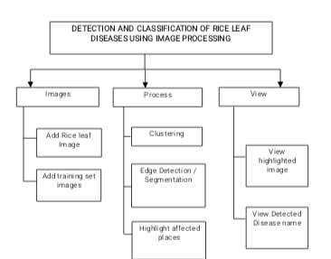
Flow Chart

Slide 13
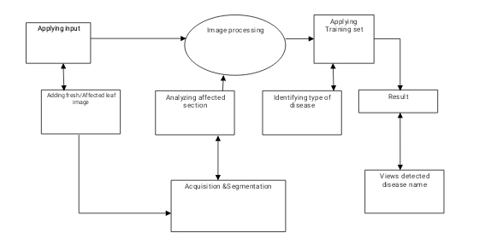
Block Diagram

Slide 14
Objectives
The main objectives of this project are,
To find the leaf is affected of fresh.
To highlight the affected places from leaf.
To find the name of the disease found.

Slide 15
System Design & Implementation
When the initial design was done for the system, the client was consulted for the acceptance of the design so that further proceedings of the system development can be carried on.
After the development of the system a demonstration was given to them about the working of the system.

Slide 16
The aim of the system illustration was to identify any malfunction of the system. after the management of the system was approved the system implemented in the concern, initially the system was run parallel with existing manual system.
The system has been tested with live data and has proved to be error free and user friendly.
Implementation is the process of converting a new or revised system design into an operational one when the initial design was done by the system; a demonstration was given to the end user about the working system

Slide 17
This process is uses to verify and identify any logical mess working of the system by feeding various combinations of test data. After the approval of the system by both end user and management the system was implemented. System implementation is made up of many activities. The six major activities are as follows.

Slide 18
System Design & implementation
CODING
Coding is the process of whereby the physical design specifications created by the analysis team turned into working computer code by the programming team
Testing Once the coding process is begin and proceed in parallel, as each program module can be tested.

Slide 19
INSTALLATION
Installation is the process during which the current system is replaced by the new system. This includes conversion of existing data, software, and documentation and work procedures to those consistent with the new system.
DOCUMENTATION
It is result from the installation process, user guides provides the information of how the use the system and its flow.

Slide 20
TRAINING AND SUPPORT
Training plan is a strategy for training user so they quickly learn to the new system. The development of the training plan probably began earlier in the project.

Slide 21
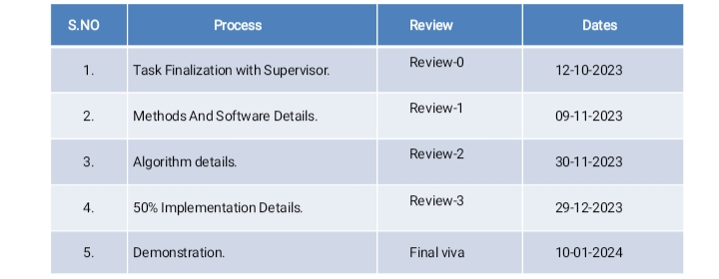
Timeline of Project

Slide 22
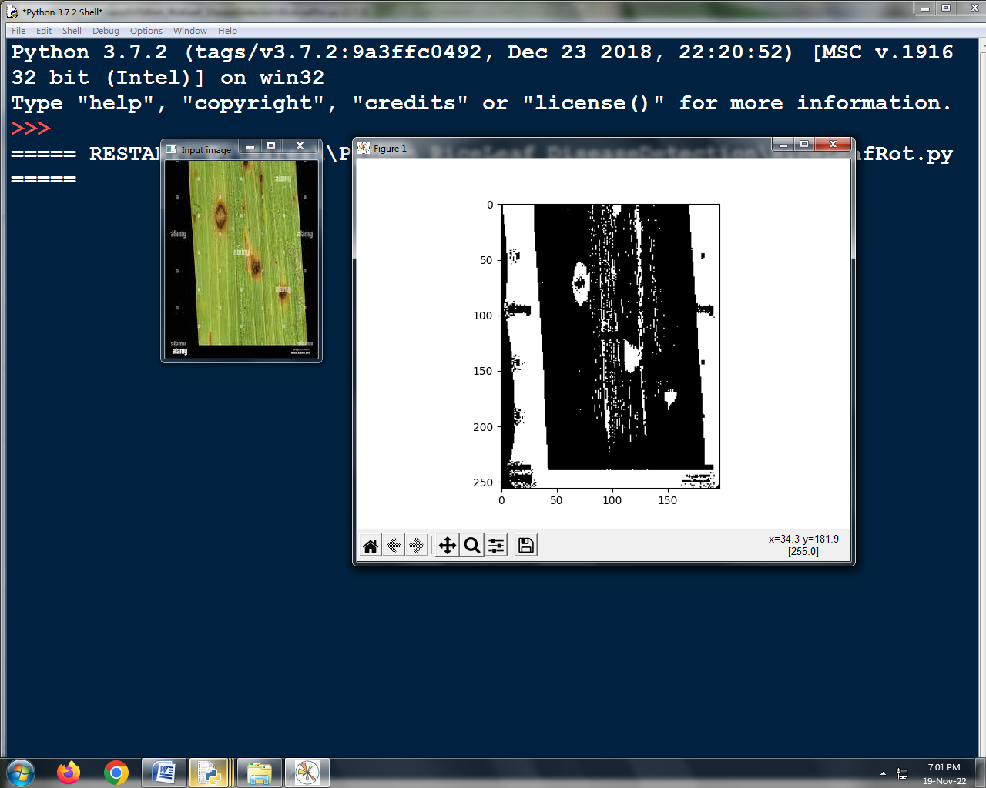
Outcomes / Results Obtained

Slide 23
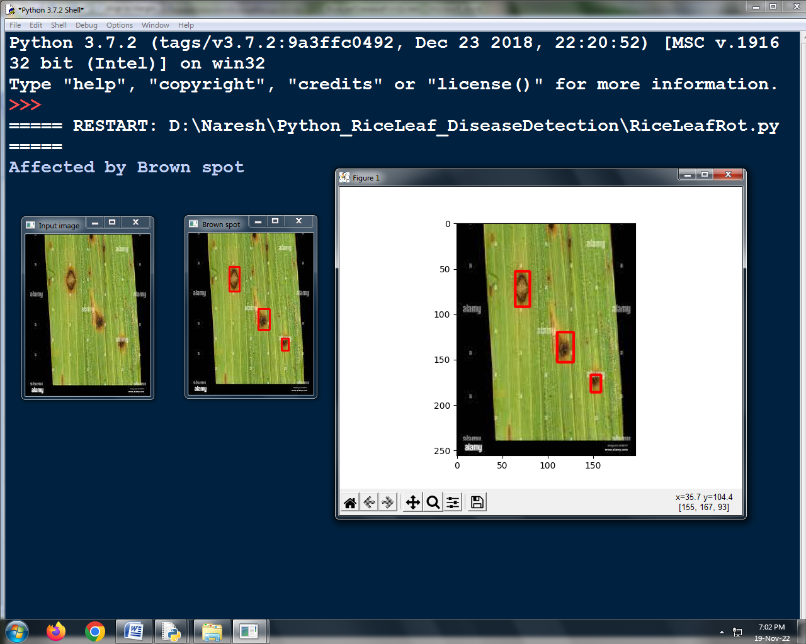
Outcomes / Results Obtained

Slide 24
Outcomes / Results Obtained

Slide 25
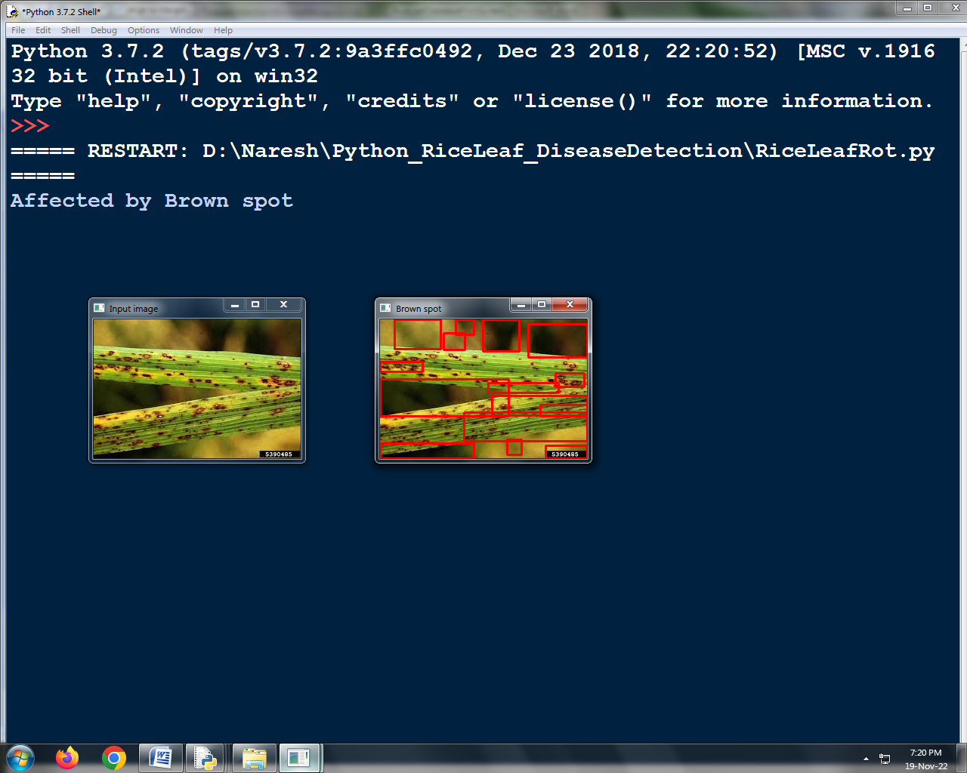
Outcomes / Results Obtained

Slide 26
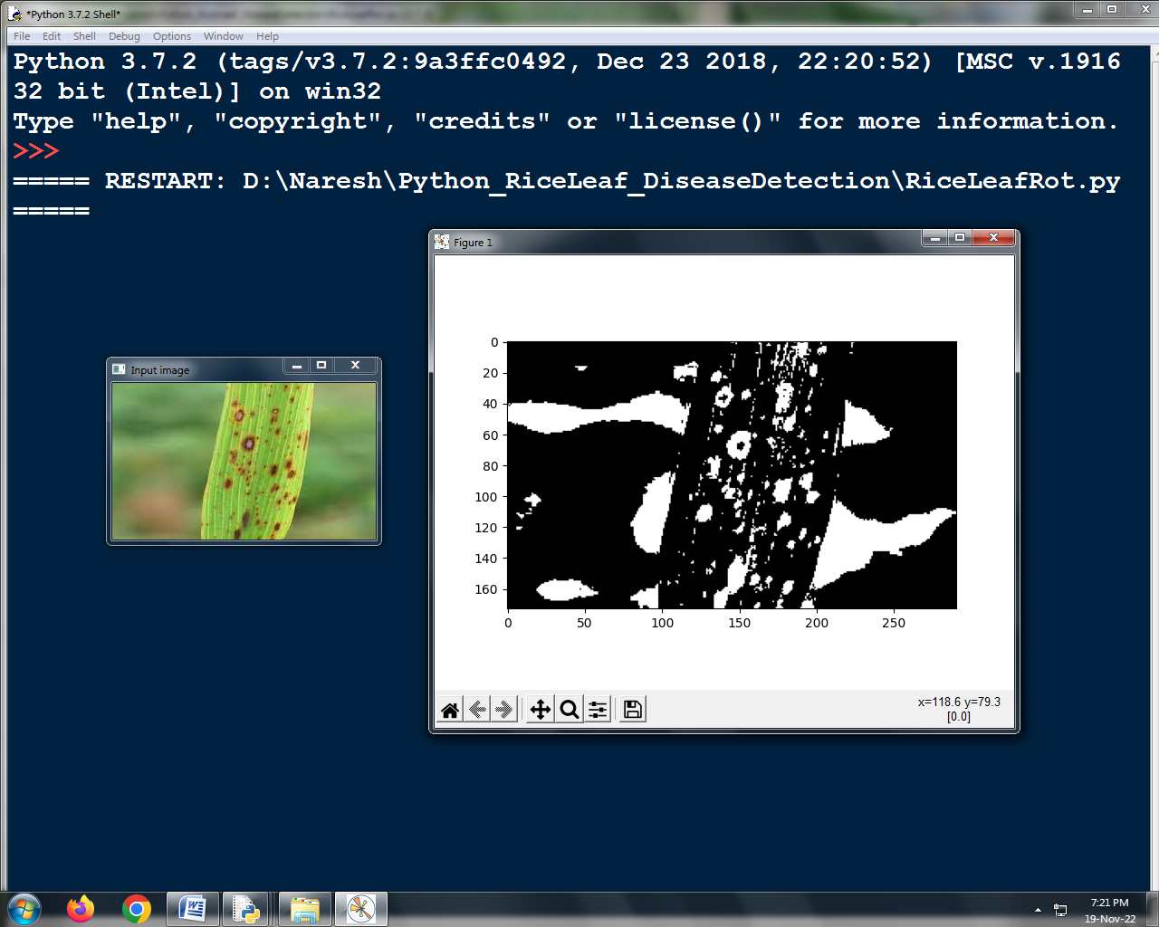
Outcomes / Results Obtained

Slide 27
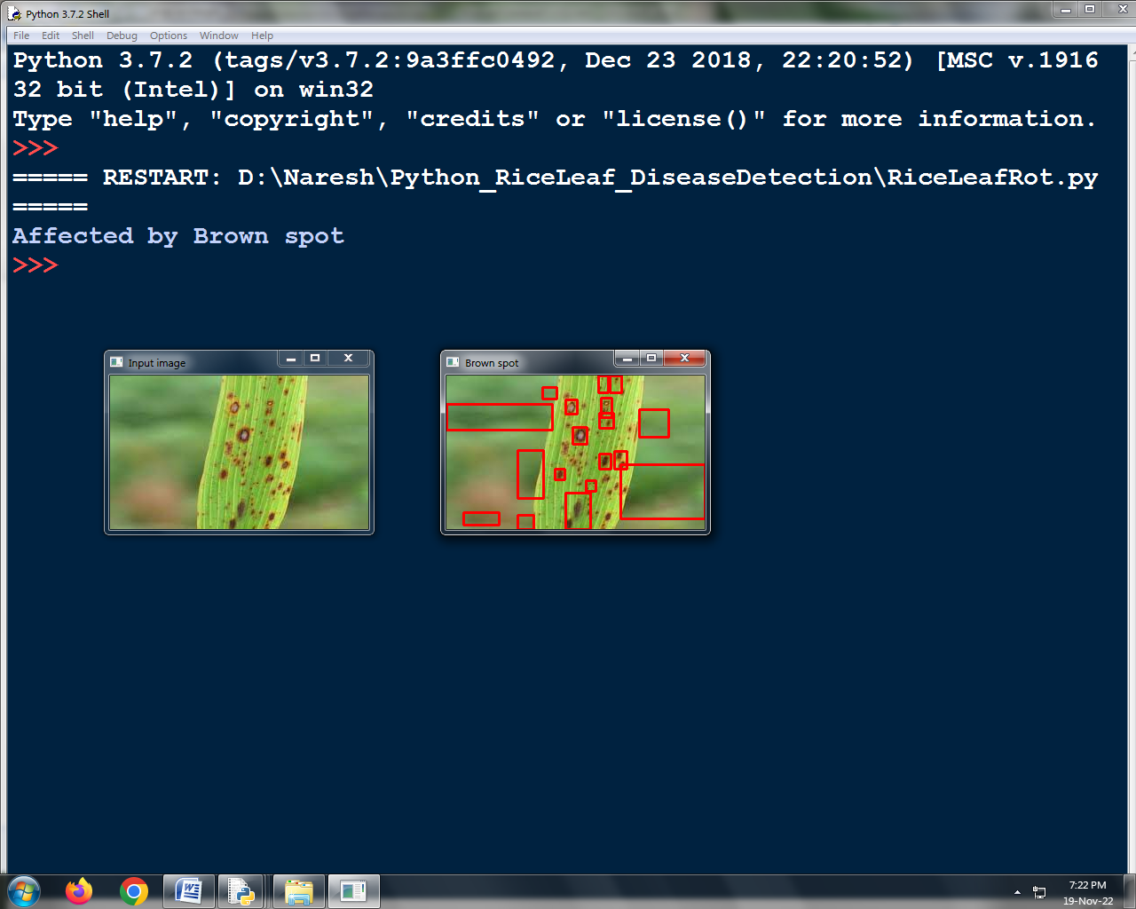
Outcomes / Results Obtained

Slide 28
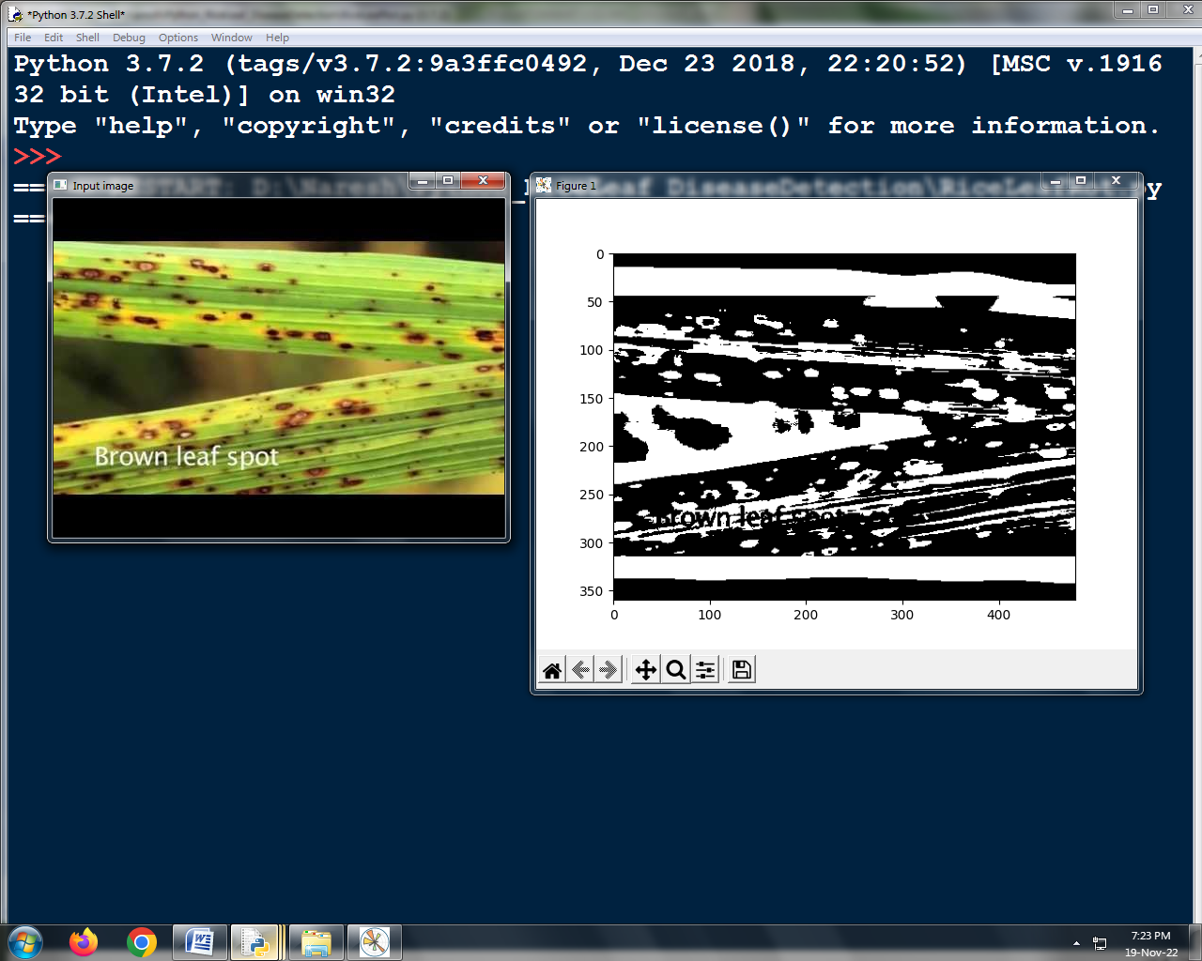
Outcomes / Results Obtained

Slide 29
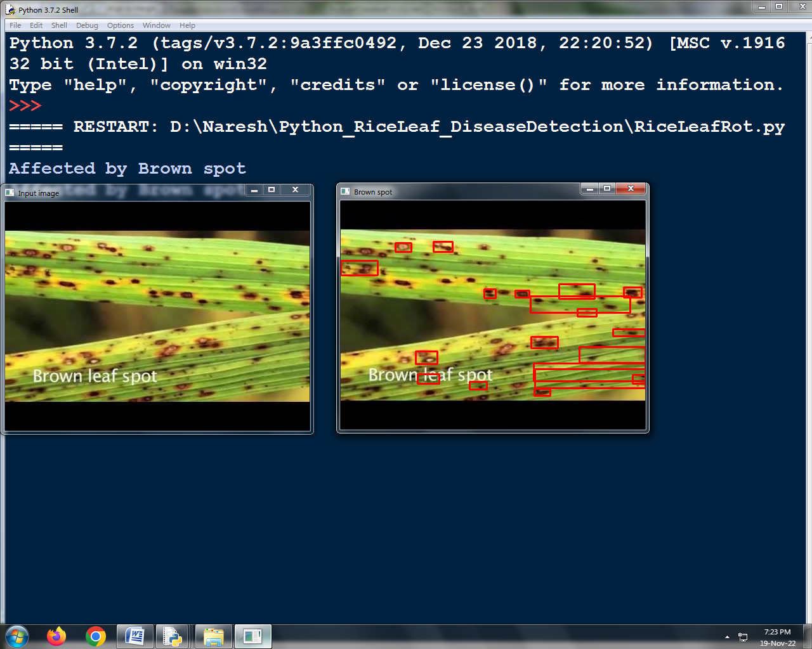
Outcomes / Results Obtained

Slide 30
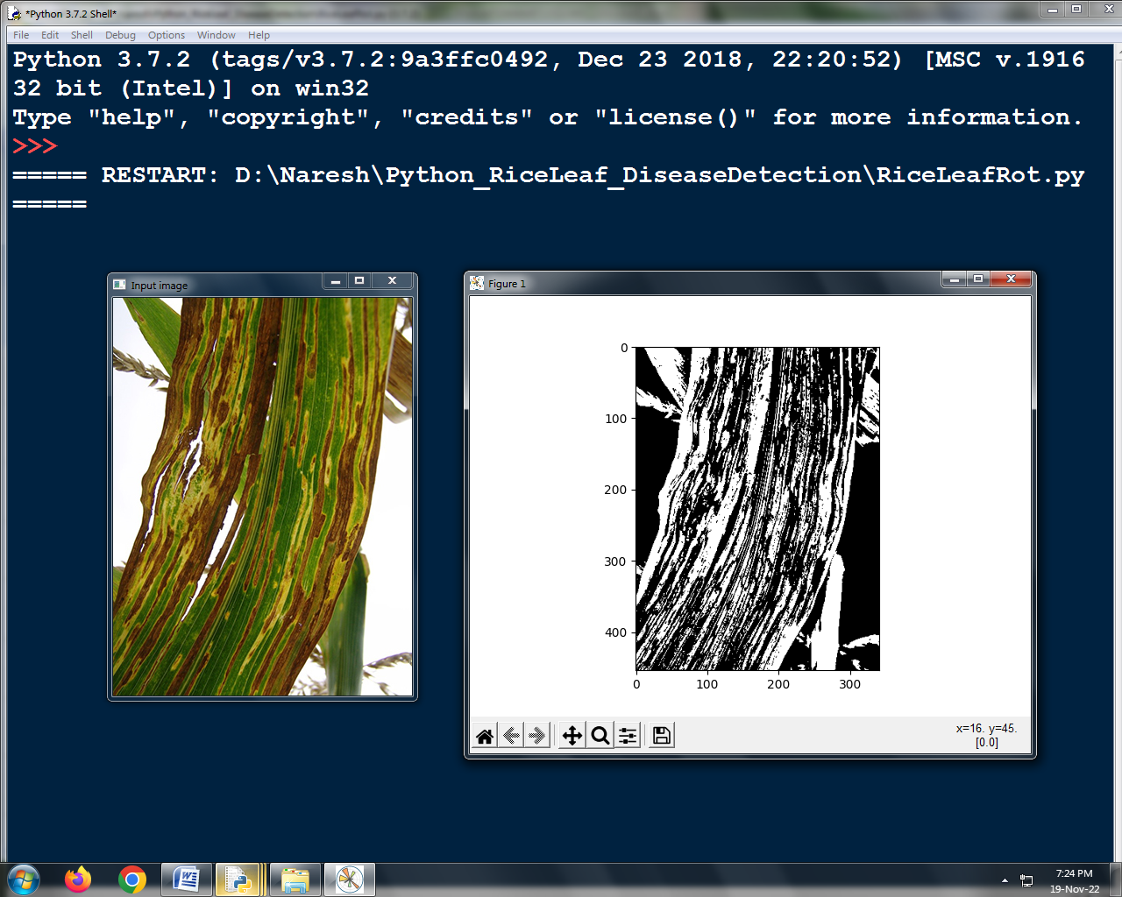
Outcomes / Results Obtained

Slide 31
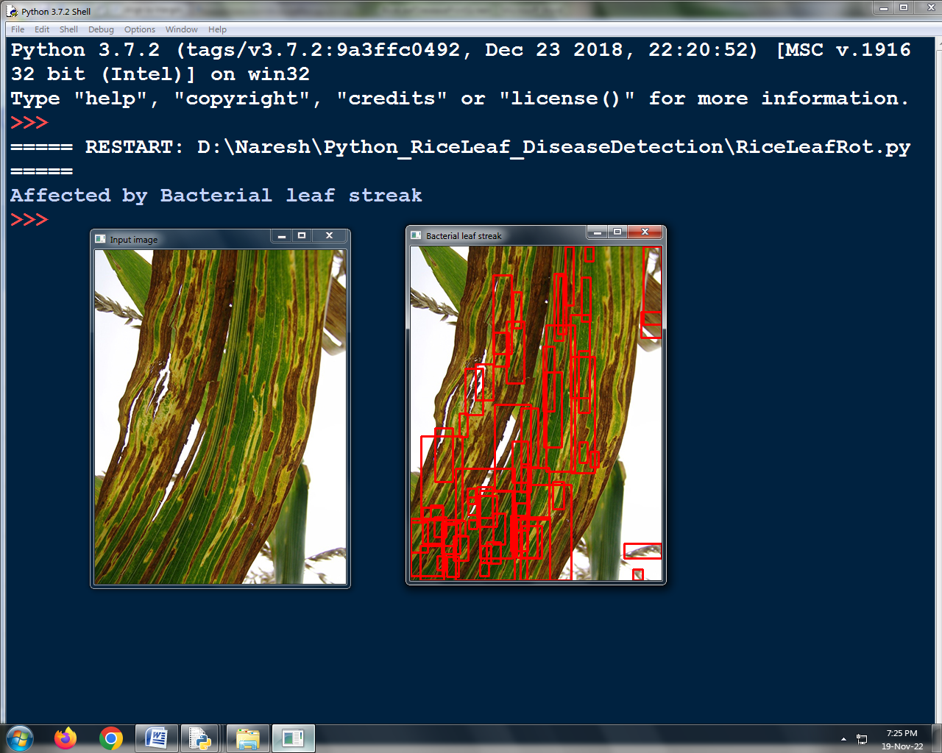
Outcomes / Results Obtained

Slide 32
Conclusion
An image processing based solution is proposed and evaluated in this project for the detection and classification of rice leaf diseases.
The proposed approach is composed of mainly three steps.
In the first step image segmentation is performed using convolutional neural network technique.
In the second step affected places are found.

Slide 33
This project will support Indian Farmers to do smart farming which helps to take time to time decisions which also save time and reduces loss of plant due to diseases.
The leading objective our project is to enhance the value of rice leaf disease detection. In the third step training and classification are performed

Slide 34
References
1. Matthew Macdonald, Robert Standefer, “The Complete Reference”, February 21, 2002, PAPERBACK, McGraw-Hill Osborne Media.
2. Greg Buczek, “Master the python programming language”, December 13, 2001, PAPERBACK, McGraw-Hill Osborne Media.
3. Scott Mitchell, Donny Mack, Stephen Walther, Doug Seven, Bill Anders, “Tips, Tutorials and Code”, August 23, 2001, Book and CD-ROM edition, Sams.

Slide 35
4. Danny Ryan, Tommy Ryan, “python image processing”, August 23, 2019, Book and CD-ROM edition, Visual.
5. Dave Mercer, “Complete python with neural network”, December 20, 2020, 2nd edition, McGraw-Hill Osborne Media.
6. Tyagi, R., Misra, D. And Yadav, R., 2023, April. Disease Prediction In Plants: Using New Era Technologies. In 2023 International Conference On Computational Intelligence, Communication Technology And Networking (Cictn) (Pp. 63-66). IEEE.

Slide 36
7. Gollapudi K, Varigonda P, Jancy S, PushpaLatha S, Helen S. Detection of Plant Disease Using Machine Learning and Deep Learning Algorithms. In2023 Eighth International Conference on Science Technology Engineering and Mathematics (ICONSTEM) 2023 Apr 6 (pp. 1-9). IEEE.
8. Rashmi N, Shetty C. A machine learning technique for identification of plant diseases in leaves. In2021 6th international conference on inventive computation technologies (ICICT) 2021 Jan 20 (pp. 481-484). IEEE.
9. Appalanaidu MV, Kumaravelan G. Plant leaf disease detection and classification using machine learning approaches: a review. Innovations in Computer Science and Engineering: Proceedings of 8th ICICSE. 2021:515-25.

Slide 37
Publication Details

Slide 38

Thank You

